Slide 1
Interactive Movie Guide App
Presented By:
Anitha 3BR22EC009
H.K.Sindhu 3BR22EC048
Anusha.C.M 3BR22EC013
Renuka 3BR22EC133

Slide 2
Problem Statement
Users struggle to find movies that match their preferences among the vast options available on streaming platforms.
Existing movie guide apps lack interactivity, personalization, and seamless integration with streaming services, leading to a disjointed and inefficient movie-watching experience.
The problem statement addressed by this code is to create an interactive movie guide application.
The application should allow users to perform various tasks related to managing movie data, including adding new movies, updating existing entries, deleting movies, displaying the entire movie database, and taking a movie quiz.

Slide 3
Introduction
An interactive movie guide app is like having a personal movie expert in your pocket.
It offers comprehensive information about movies, including plot summaries, cast details, reviews, and ratings.
But what makes it truly interactive is its ability to tailor recommendations based on your preferences.
Whether you're in the mood for action, romance, or comedy, the app suggests movies that match your tastes.
It might even provide trivia, behind-the-scenes insights, and curated lists to enhance your movie-watching experience.
Overall, it's a user-friendly tool designed to make choosing what to watch a breeze.

Slide 4
Module Description
Classes:
There are two classes defined: Movie and MovieDatabase. Movie is an abstract base class (ABC) with an abstract method display_info(). MovieDatabase is a class that manages a collection of movies and implements methods for adding, displaying, updating, and deleting movies, as well as for conducting a movie quiz.
Methods:
add_movie(): Prompts the user to input details of a movie and adds it to the movie database.
display_movies(): Displays all movies currently stored in the database.
update_movie(): Allows the user to update information about a specific movie.
delete_movie(): Allows the user to delete a movie from the database. 7
take_quiz(): Conducts a movie quiz by asking predefined questions and evaluating user responses.

Slide 5
Attributes:
movies: A dictionary storing movie titles as keys and their corresponding details (director, year, genre) as values.
score: Tracks the score of the user during the quiz.
quiz_questions: A dictionary containing quiz questions as keys and their corresponding answers as values.
Flow:
The program runs in an infinite loop, allowing the user to perform various actions. Based on user input, different methods of the MovieDatabase class are executed. The program terminates when the user chooses to exit.
Interactivity: The program provides a user-friendly interface, allowing users to interactively manage the movie database by adding, updating, and deleting movies, as well as taking a quiz.

Slide 6
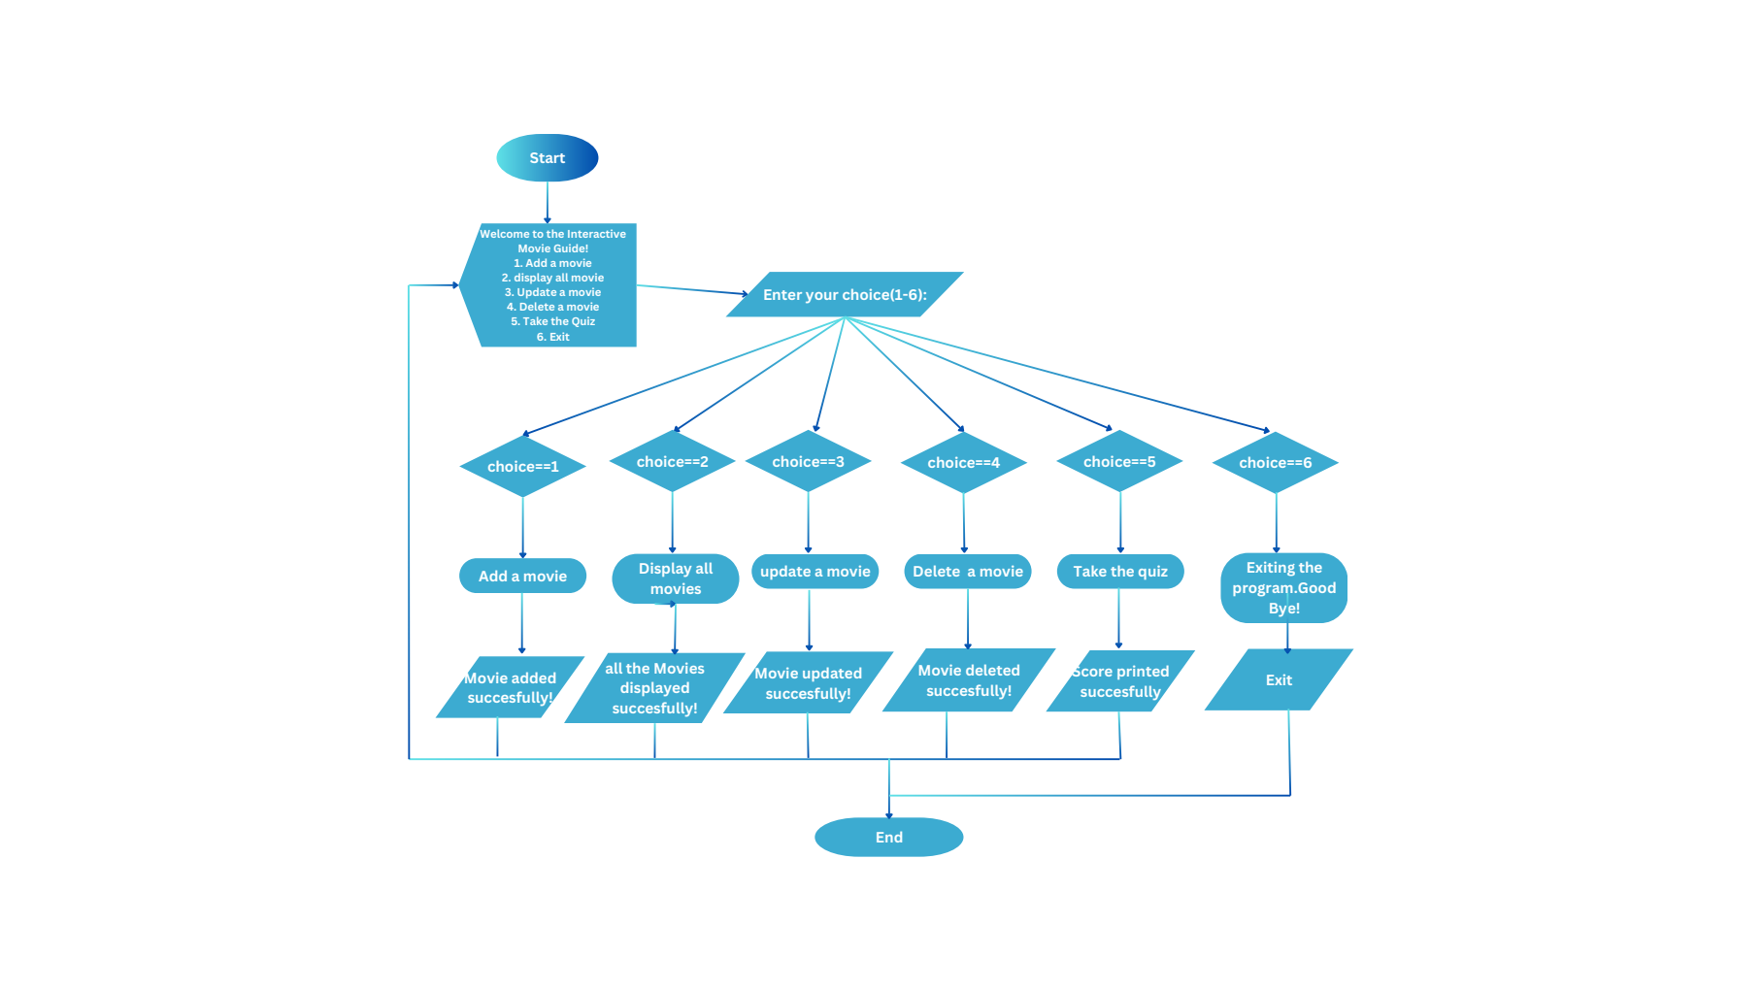
Flow Chart

Slide 7
Def Function
from abc import ABC, abstractmethod
class Movie(ABC):
def __init__(self, title, released_year, director, genre):
self.title = title
self.released_year = released_year
self.director = director
self.genre = genre
@abstractmethod
def display_info(self):
pass

Slide 8
class MovieDatabase:
def __init__(self):
self.movies = {}
self.score = 0
self.quiz_questions = {
"What year was the movie 'KGF' released?": "2018",
"Who directed the movie 'Kantara'?": "Rishab Shetty",
"What is the genre of the kgf movie ?": "action"
}
def add_movie(self):
title = input("Enter the movie title: ")
director = input("Enter the director's name: ")
year = input("Enter the release year: ")
genre = input("Enter the genre: ")
self.movies[title] = {"Director": director, "Year": year, "Genre": genre}
print(f"{title} added to the movie database.")

Slide 9
def display_movies(self):
if self.movies:
print("Movie database:")
for title, info in self.movies.items():
print(f"Title: {title}, Director: {info['Director']}, Year: {info['Year']}, Genre: {info['Genre']}")
else:
print("No movies found in the movie database.")
def update_movie(self):
title = input("Enter the title of the movie you want to update: ")
if title in self.movies:
print("Enter new information (leave blank to keep current value):")
director = input(f"Director ({self.movies[title]['Director']}): ") or self.movies[title]['Director']
year = input(f"Year ({self.movies[title]['Year']}): ") or self.movies[title]['Year']
genre = input(f"Genre ({self.movies[title]['Genre']}): ") or self.movies[title]['Genre']
self.movies[title] = {"Director": director, "Year": year, "Genre": genre}
print(f"{title} updated in the movie database.")
else:
print(f"{title} not found in the movie database.")

Slide 10
def delete_movie(self):
title = input("Enter the title of the movie you want to delete: ")
if title in self.movies:
del self.movies[title]
print(f"{title} deleted from the movie database.")
else:
print(f"{title} not found in the movie database.")
def take_quiz(self):
print("Welcome to the Movie Quiz!")
for question, answer in self.quiz_questions.items():
user_answer = input(question + " ")
if user_answer.lower() == answer.lower():
print("Correct!")
self.score += 1
else:
print("Incorrect.")
print(f"You scored {self.score} out of {len(self.quiz_questions)}.")

Slide 11
Main Program
from movie_database import MovieDatabase
movie_database = MovieDatabase()
while True:
print("\nWelcome to the Interactive Movie Guide!")
print("1. Add a movie")
print("2. display all movie")
print("3. Update a movie")
print("4. Delete a movie")
print("5. Take the Quiz")
print("6. Exit")
choice = input("Enter your choice (1-6): ")
if choice == '1':
movie_database.add_movie()

Slide 12
elif choice == '2':
movie_database.display_movies()
elif choice == '3':
movie_database.update_movie()
elif choice == '4':
movie_database.delete_movie()
elif choice == '5':
movie_database.take_quiz()
elif choice == '6':
print("Exiting the program. Goodbye!")
break
else:
print("Invalid choice. Please enter a number from 1 to 6.")

Slide 13
Output
Welcome to the Interactive Movie Guide!
1. Add a movie
2. display all movie
3. Update a movie
4. Delete a movie
5. Take the Quiz
6. Exit
Enter your choice (1-6): 1
Enter the movie title: kgf
Enter the director's name: Prashant
Enter the release year: 2018
Enter the genre: action
kgf added to the movie database
.Welcome to the Interactive Movie Guide!
1. Add a movie
2. display all movie
3. Update a movie
4. Delete a movie
5. Take the Quiz
6. Exit
Enter your choice (1-6): 1
Enter the movie title: kantara
Enter the director's name: Rishab
Enter the release year: 2022
Enter the genre: action thriller
kantara added to the movie database.

Slide 14
Welcome to the Interactive Movie Guide!
1. Add a movie
2. display all movie
3. Update a movie
4. Delete a movie
5. Take the Quiz
6. Exit
Enter your choice (1-6): 2
Movie database:
Title:kgf,Director:prashant, Year: 2018, Genre: action
Title: kantara, Director: rishab, Year: 2022, Genre: action thriller
Welcome to the Interactive Movie Guide!
1. Add a movie
2. display all movie
3. Update a movie
4. Delete a movie
5. Take the Quiz
6. Exit
Enter your choice (1-6): 3
Enter the title of the movie you want to update: kgf
Enter new information (leave blank to keep current value):Director (prashant):
Year (2018): 2019
Genre (action):
kgf updated in the movie database.

Slide 15
Welcome to the Interactive Movie Guide!
1. Add a movie
2. display all movie
3. Update a movie
4. Delete a movie
5. Take the Quiz
6. Exit
Enter your choice (1-6): 2
Movie database:
Title: kgf , Director : Prashant , Year: 2019, Genre: action
Title: kantara , Director: Rishab , Year: 2022, Genre: action thriller
Welcome to the Interactive Movie Guide!
1. Add a movie
2. display all movie
3. Update a movie
4. Delete a movie
5. Take the Quiz
6. Exit
Enter your choice (1-6): 4
Enter the title of the movie you want to delete: kantara
kantara deleted from the movie database.

Slide 16
Welcome to the Interactive Movie Guide!
1. Add a movie
2. display all movie
3. Update a movie
4. Delete a movie
5. Take the Quiz
6. Exit
Enter your choice (1-6): 2
Movie database:
Title: kgf, Director: prashant, Year: 2019, Genre: action
Welcome to the Interactive Movie Guide!
1. Add a movie
2. display all movie
3. Update a movie
4. Delete a movie
5. Take the Quiz
6. Exit
Enter your choice (1-6): 5
Welcome to the Movie Quiz!
What year was the movie 'KGF' released? 2018 Correct!
Who directed the movie 'Kantara'? Rishab Incorrect!.
What is the genre of the kgf movie ? Action Correct!
You scored 2 out of 3.

Slide 17
Welcome to the Interactive Movie Guide!
1. Add a movie
2. display all movie
3. Update a movie
4. Delete a movie
5. Take the Quiz
6. Exit
Enter your choice (1-6): 6
Exiting the program.
Goodbye! Process finished with exit code 0

Slide 18
Challenges
Uploading this code might face challenges like ensuring stable internet for file transfer, managing versions using Git, conducting thorough code reviews, documenting functionality, testing for reliability, ensuring security measures, and integrating with existing systems.

Slide 19
Conclusion
The code creates an interactive movie database system in Python. It lets users add, display, update, or delete movies, and also take a movie quiz. It's built using classes, methods, and a menu-driven interface.

Slide 20


